Slide 1

Uncertainty
UNIT-V
Notes:
1

Slide 2

example of uncertain reasoning:
Agents may need to handle uncertainty.
diagnosing a dental patient’s toothache Diagnosis.
whether for medicine, automobile repair, or whatever—almost always involves uncertainty.
Notes:
2

Slide 3
Let us try to write rules for dental diagnosis using propositional logic, so that we can see how the logical approach breaks down.
Consider the following simple rule:
Toothache ⇒ Cavity .
The problem is that this rule is wrong. Not all patients with toothaches have cavities; some of them have gum disease etc.
Toothache ⇒ Cavity ∨ GumProblem ∨ Abscess . . .
Notes:
3

Slide 4
Unfortunately, in order to make the rule true, we have to add an almost unlimited list of possible problems.
We could try turning the rule into a causal rule:
Cavity ⇒ Toothache .
But this rule is not right either; not all cavities cause pain.
Notes:
4

Slide 5
Trying to use logic to cope with a domain like medical diagnosis thus fails for three main reasons:
Laziness: It is too much work to list the complete set of antecedents or consequents needed to ensure an exceptionless rule and too hard to use such rules.
Theoretical ignorance: Medical science has no complete theory for the domain.
Practical ignorance: Even if we know all the rules, we might be uncertain about a particular patient because not all the necessary tests have been or can be run.
Notes:
5

Slide 6
The agent’s knowledge can at best provide only a degree of belief in the relevant sentences.
Our main tool for dealing with degrees of belief is probability theory.
the epistemological commitments are different: a logical agent believes each sentence to be true or false or has no opinion.
whereas a probabilistic agent may have a numerical degree of belief between 0 (for sentences that are certainly false) and 1 (certainly true).
Notes:
6

Slide 7
an 80% chance—that is,a probability of 0.8—that the patient who has a toothache has a cavity.
This belief could be derived from statistical data—80% of the toothache patients seen so far have had cavities—or from some general dental knowledge, or from a combination of evidence sources.
Notes:
7

Slide 8
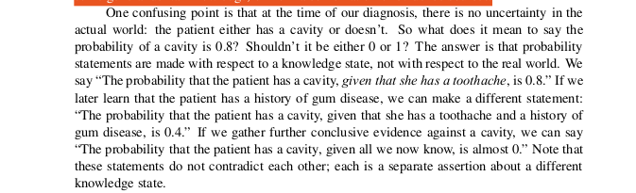
Notes:
8

Slide 9
Probability notation
probabilistic assertions talk about how probable the various worlds are.
In probability theory, the set of all possible worlds is called the sample space.
For example, if we are about to roll two (distinguishable) dice, there are 36 possible worlds to consider: (1,1), (1,2), . . ., (6,6).
The Greek letter Ω (uppercase omega) is used to refer to the sample space, and ω (lowercase omega) refers to elements of the space, that is, particular possible worlds.
Notes:
9

Slide 10
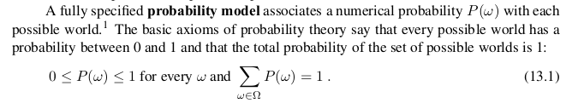
Notes:
10

Slide 11
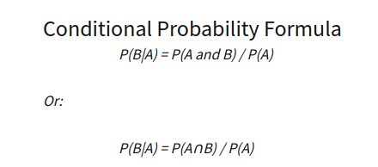
Conditional probability
Conditional probability is defined as the likelihood of an event or outcome occurring, based on the occurrence of a previous event or outcome.
It is often stated as the probability of B given A and is written as P(B|A), where the probability of B depends on that of A happening.
Notes:
11

Slide 12
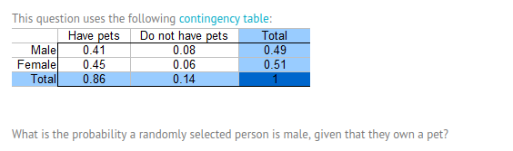
Notes:
12

Slide 13
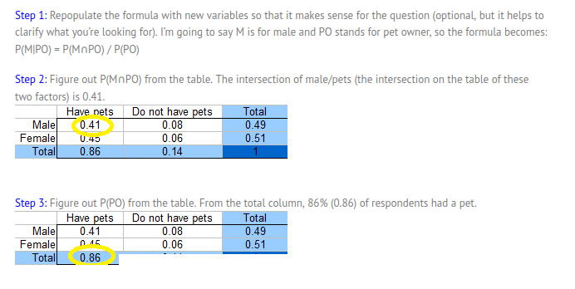

Notes:
13

Slide 14
An Alternate Way To Calculate Conditional Probability
Specifically, one conditional probability can be calculated using the other conditional probability
P(B|A) = P(A|B) * P(B) / P(A).
P(A|B) = P(B|A) * P(A) / P(B)
This alternate calculation of the conditional probability is referred to as Bayes Rule or Bayes Theorem.
Notes:
14

Slide 15
Bayes Theorem:
Principled way of calculating a conditional probability without the joint probability.
P(A|B): Posterior probability.
P(A): Prior probability.
P(B|A): Likelihood.
P(B): Evidence.
Notes:
15

Slide 16
This allows Bayes Theorem to be restated as:
Posterior = Likelihood * Prior / Evidence.
Ex:What is the probability that there is fire given that there is smoke?
Where P(Fire) is the Prior, P(Smoke|Fire) is the Likelihood, and P(Smoke) is the evidence:
P(Fire|Smoke) = P(Smoke|Fire) * P(Fire) / P(Smoke)
Notes:
16

Slide 17

example, a doctor knows that the disease meningitis causes the patient to have a stiff neck,say, 70% of the time. The doctor also knows some unconditional facts: the prior probability that a patient has meningitis is 1/50,000, and the prior probability that any patient has a stiff neck is 1%. Letting s be the proposition that the patient has a stiff neck and m be the proposition that the patient has meningitis.
Notes:
17

Slide 18
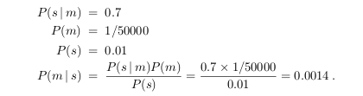
That is, we expect less than 1 in 700 patients with a stiff neck to have meningitis.
Notes:
18

